Slide 1
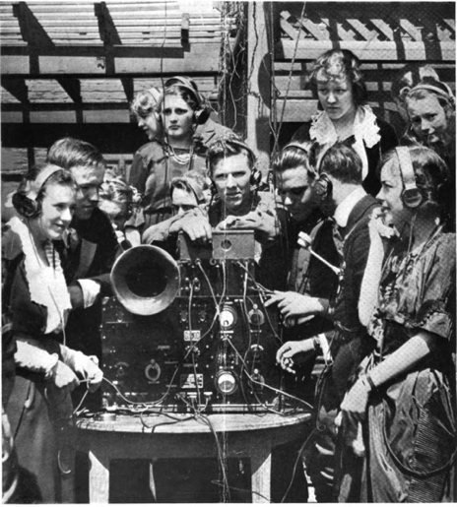
Attention
Danielle Navarro
http://compcogscisydney.org/psyc2071/

Slide 2
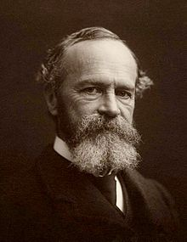


Structure of the lecture
Some definitions
Auditory attention
Visual attention
… and visual search

Slide 3
Part 1: Some definitions

Slide 4
“Attention is…the taking into possession of the mind, in clear and vivid form, of one out of what seem several simultaneously possible objects or trains of thought.
- William James, 1890

Slide 5
How many things are we paying attention to?
“Attention is…the taking into possession of the mind, in clear and vivid form, of one out of what seem several simultaneously possible objects or trains of thought.

Slide 6
How many things are we paying attention to?
“Attention is…the taking into possession of the mind, in clear and vivid form, of one out of what seem several simultaneously possible objects or trains of thought.
What kind of thing are we paying attention to?

Slide 7
How many things are we paying attention to?
“Attention is…the taking into possession of the mind, in clear and vivid form, of one out of what seem several simultaneously possible objects or trains of thought.
What kind of thing are we paying attention to?
Are we actively controlling this attention or not?

Slide 8
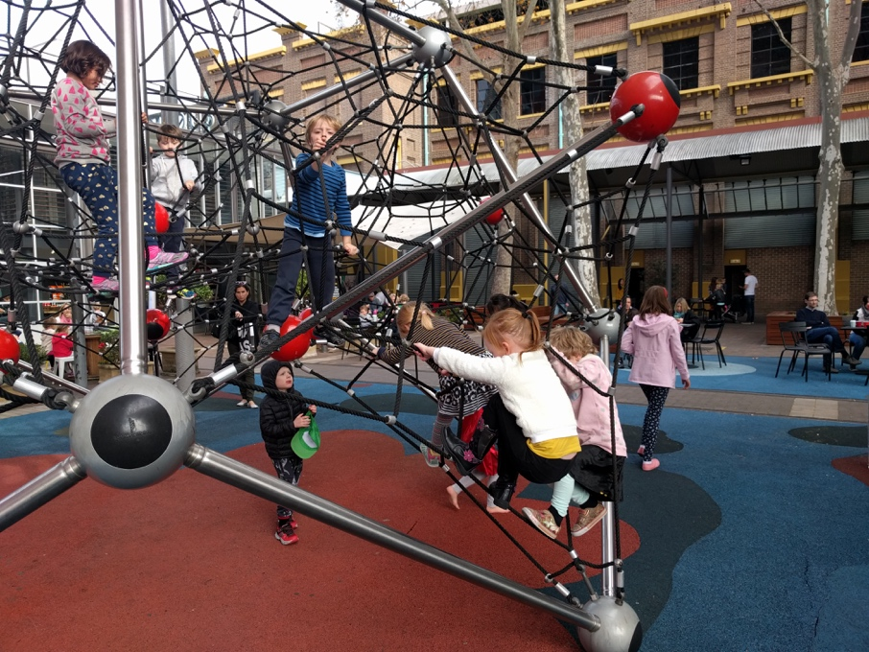
How many targets?
Focused attention (or selective attention)
Attending to one thing and ignoring other things
At the park, if I have one child my attention is focused on what that child is doing… my child is the target of my attention

Slide 9
How many targets?
Divided attention (multitasking)
Tracking multiple things & responding as necessary
If I have multiple kids in my care, however, my attention is now divided between them
(This is much harder!)

Slide 10
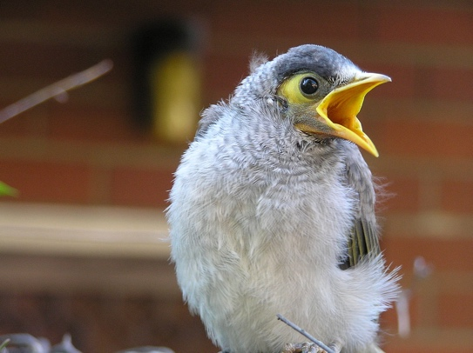
What kind of target?
External attention: the target of attention is something in the perceptual environment
Auditory attention – paying attention to sounds
Visual attention – paying attention to visual stimuli
Cross-modal attention – attending to multiple senses
Visual
Auditory
Cross-modal

Slide 11
What kind of target?
Internal attention
The target of attention is something that you’re thinking about, and not part of the perceptual environment
Daydreaming directs attention inwards to one’s own thoughts

Slide 12
What controls attention?
Active attention (endogenous):
Exercising top-down control over our own attention in order to achieve our goals
I choose to direct my attention to this because I want to

Slide 13
What controls attention?
Passive attention (exogenous):
Bottom up control over attention, where something in the environment (e.g., loud noise) demands attention
This calls attention to itself

Slide 14
Summary
How many?
What kind?
Control?
Focused vs
Divided
External vs
Internal
Active vs Passive

Slide 15
Summary
How many?
What kind?
Control?
Focused vs
Divided
External vs
Internal
Active vs Passive

Slide 16


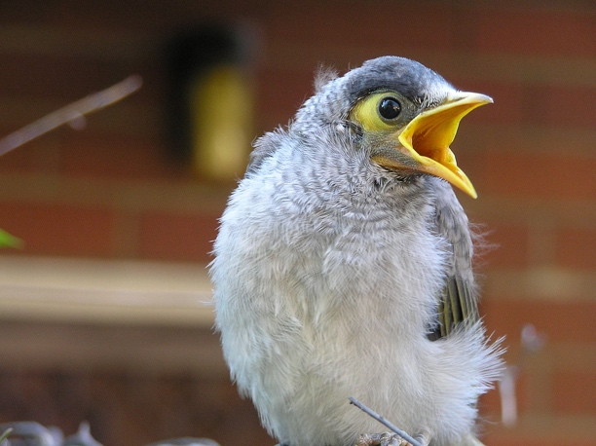
Part 2: Auditory attention

Slide 17
The cocktail party problem

Slide 18
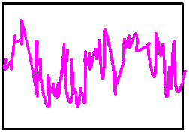
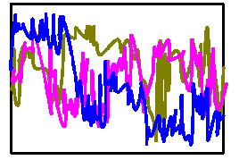
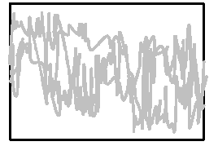
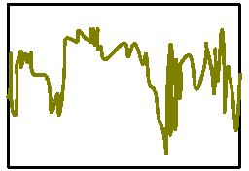
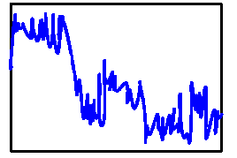
Schematic illustration
There are lots of “sources”
Each source produces a signal
The signals are jumbled together
And we need to sort this mess out

Slide 19
Theoretical idea?
An “attentional filter” separates the sources and selects the target for processing

Slide 20



Male voice:
Blackheath or Blackburn?
Female voice: illustrious or illumination?

Slide 21
The shadowing task
RIGHT EAR: Someone must have laid false accusations against Josef K
“Someone must have laid false accusations against Josef K”
LEFT EAR: Why does Ross, the largest of the friends, simply not eat the others?
Early results (Cherry 1953, Moray 1959):
We’re good at shadowing the target source
Very little is processed from the other source
Suggests…

Slide 22
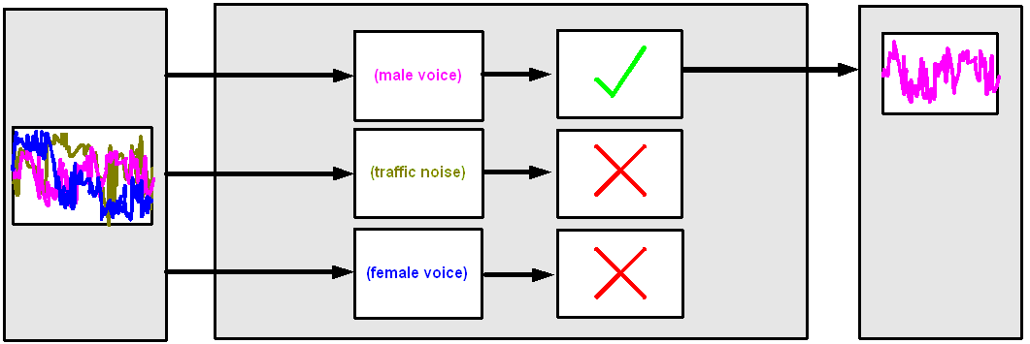
Early selection (Broadbent 1954)
“Pre-attentive” low-level analysis picks up some of the basic properties of the different signals

Slide 23
Early selection (Broadbent 1954)
Attention selects a target for further processing: we become fully conscious of that signal
Processing of the unattended signals stops, and we are aware only of the results of the pre-attentive analysis

Slide 24
Problems with Broadbent’s filter

Slide 25
Semantic* content drives attention?
(* semantics = meaning)
RIGHT EAR: Someone must have laid false not eat the others?
“Someone must have laid false accusations against Josef K”
LEFT EAR: Why does Ross, the largest of the friends, simply accusations against Josef K
Gray & Wedderburn (1960)… semantic content switched ears, and people smoothly track it

Slide 26
Semantic content of unattended source influences processing
RIGHT EAR: robot, cockroach, lost, yellow, terminus
“robot, cockroach, um... lost yellow, terminus”
LEFT EAR: green, dispense, missing, quick waiter,
Lewis (1970) presented synonyms in both ears. Semantic interference occurs, with reaction time (RT) slower when the synonym is presented.

Slide 27
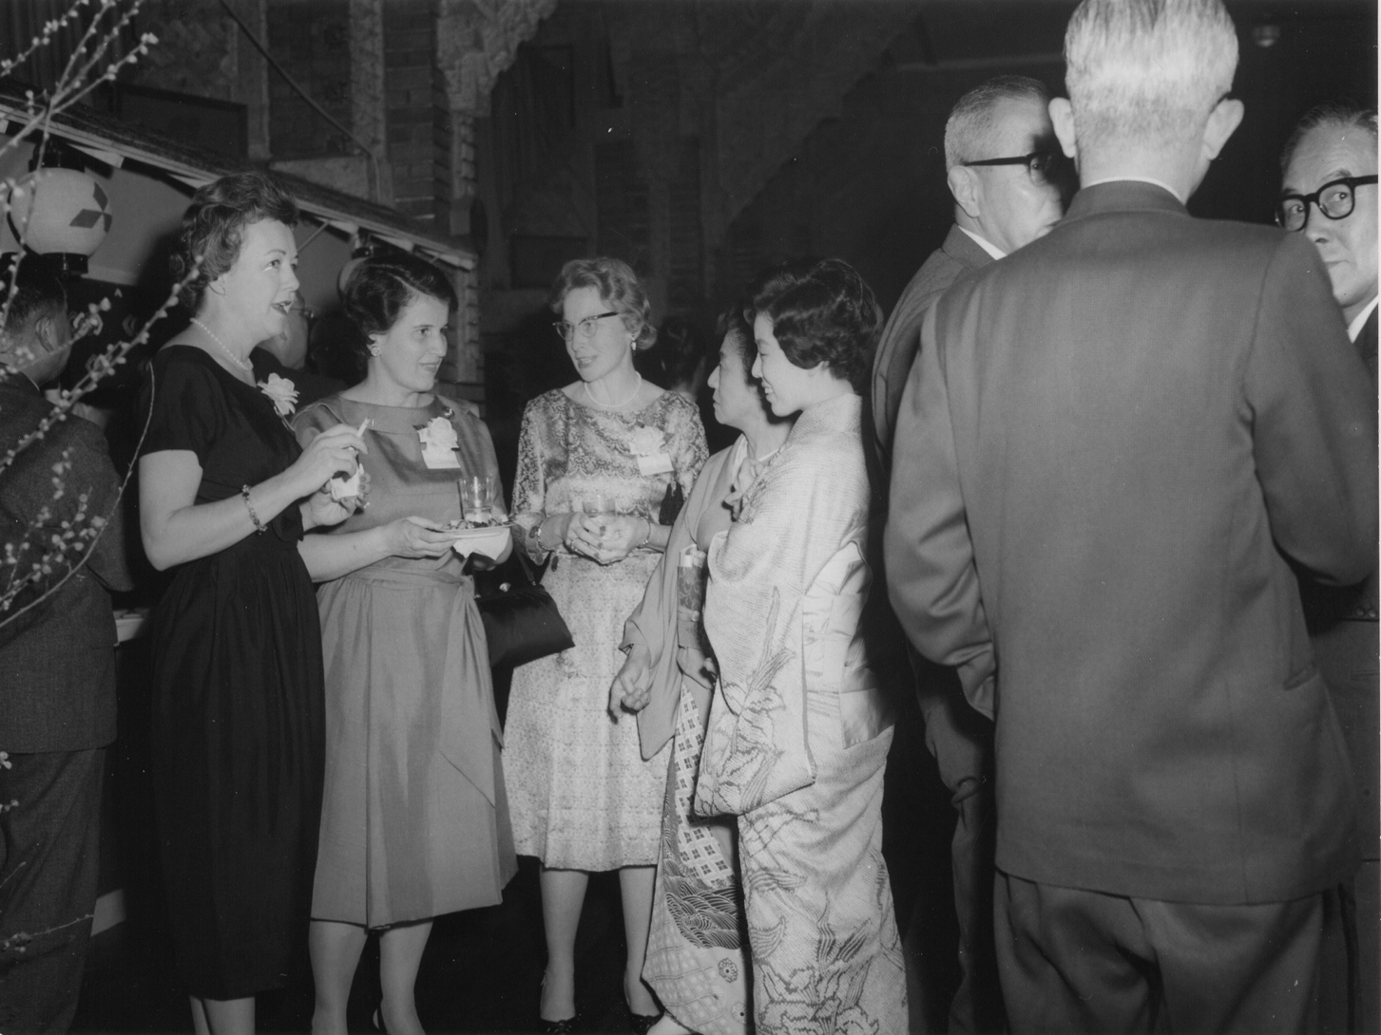
And some words “pop out” at you even when you’re not listening
blah blah blah blah
hey that’s my name!
blah blah MARIA blah blah
(*note: this is passive attention)
(Moray 1959)

Slide 28
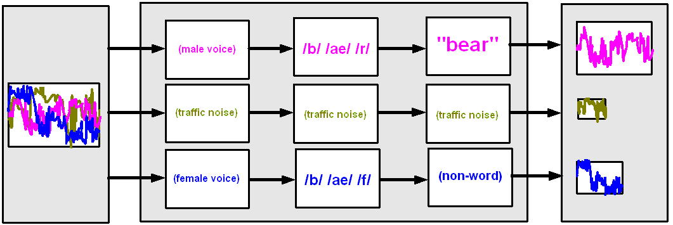
Late selection
Late selection theory says that everything is processed.
The reason we aren’t aware of all this is that our memory has limited capacity
(Deutsch & Deutsch 1963)

Slide 29
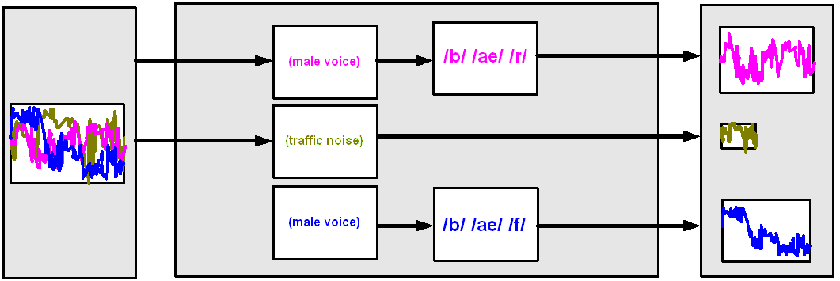
Attenuation theory
Every signal is processed up to the point where it can be separated from the target, and then processing stops
Traffic noise is very different from the female voice so it is filtered early
The male voice is more similar to the female voice so it is filtered late
(Treisman 1964)

Slide 30
Summary
Very little conscious awareness of unattended source
But there are special words that “pop out”, and there is some semantic interference from unattended source
Suggests late selection or attenuation

Slide 31

Part 3: Do we get the same effects in visual attention?

Slide 32
Copy the female voice?

Slide 33
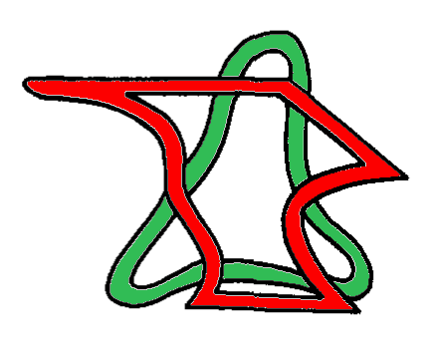
Visual analog of the shadowing task
(Rock & Gutman 1981)
Task: rate the aesthetic appeal of the RED shape
Copy the female voice?

Slide 34

Time pressure: the experiment presented several of these, with a brief exposure duration

Slide 35
At test, people were shown each shape in isolation and asked if they had seen it…
Original item
(attend to RED)

Slide 36

At test, people were shown each shape in isolation and asked if they had seen it…
Shapes originally in the attended colour are recalled
Original item
(attend to RED)

Slide 37

At test, people were shown each shape in isolation and asked if they had seen it…
Shapes originally in the attended colour are recalled
Original item
(attend to RED)
Shapes originally in the unattended colour are not

Slide 38
Conclusion: similar results in visual attention as in auditory attention
RIGHT
LEFT

Slide 39
Analog of semantic interference?
RIGHT EAR: robot, cockroach, lost, yellow, terminus
LEFT EAR: green, dispense, missing, quick waiter,

Slide 40
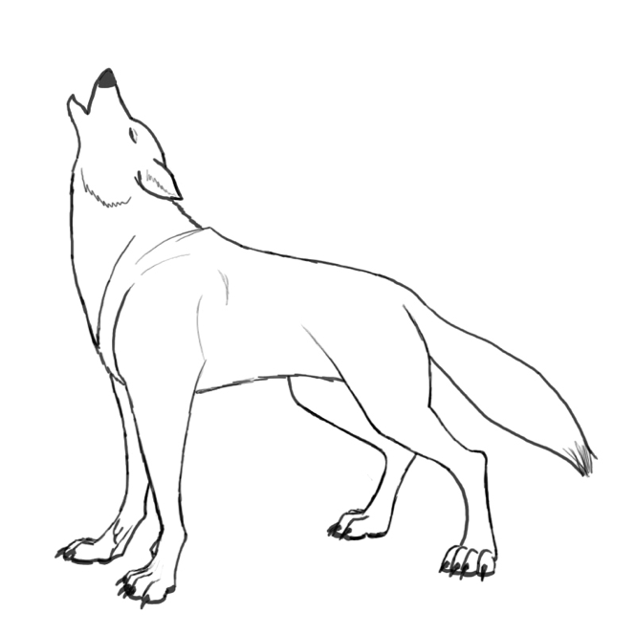
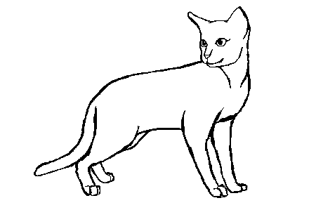
Negative priming
(Tipper 1985)
RIGHT EAR: robot, cockroach, lost, yellow, terminus
WOLF
LEFT EAR: green, dispense, missing, quick waiter,
CAT

Slide 41

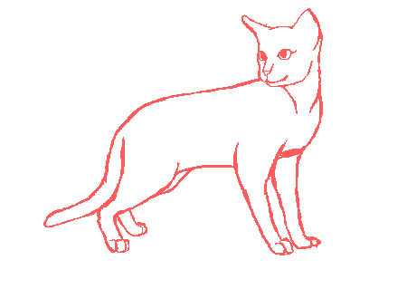
As before we have overlapping objects in different colours
The task is to name the RED object

Slide 42

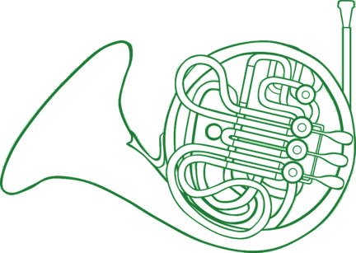



Series of images presented

Slide 43
Attended stream
Unattended stream

Slide 44
Semantically related prime in the UNATTENDED stream…
… slows down response time to the target item in the ATTENDED stream

Slide 45
Requires late selection because the meaning of “wolf” has an effect
Makes it harder to attend to CAT later
Ignoring WOLF now

Slide 46

Auditory
Visual
Semantic interference (Lewis 1970)
Negative priming (Tipper 1985)
Again, visual attention seems to be very similar to auditory attention
lost
missing

Slide 47
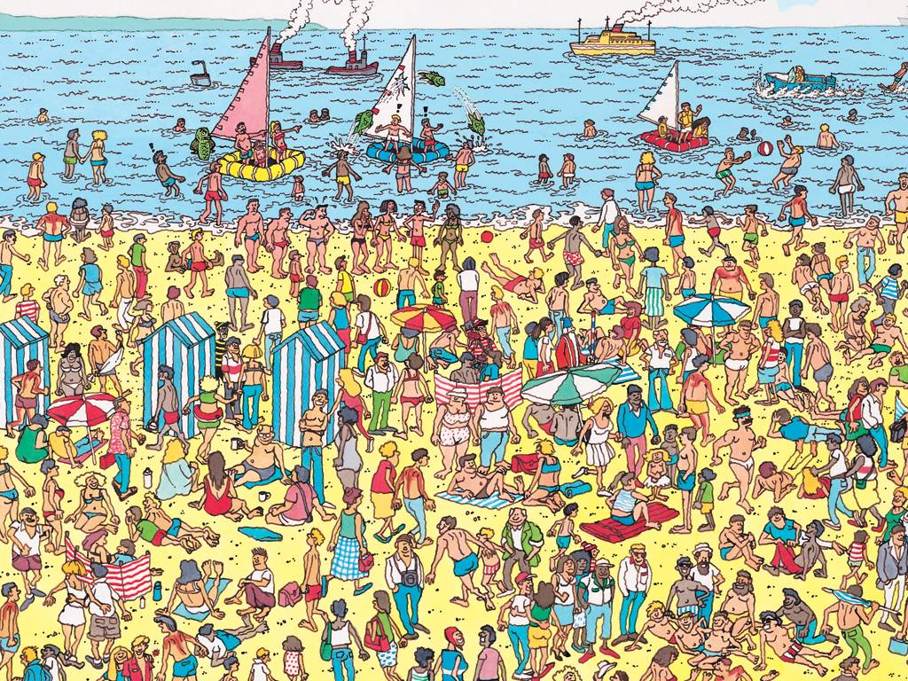
Part 4: Visual search

Slide 48
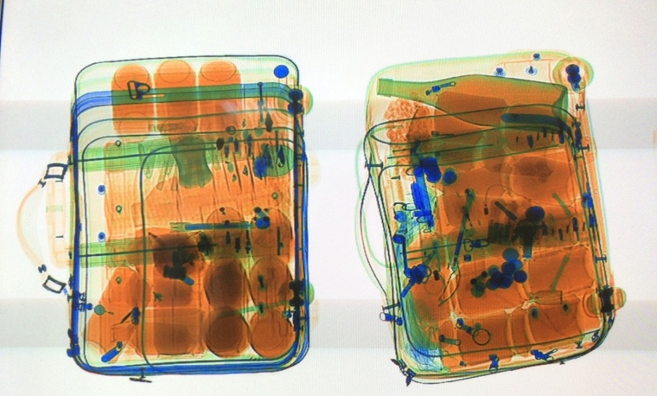

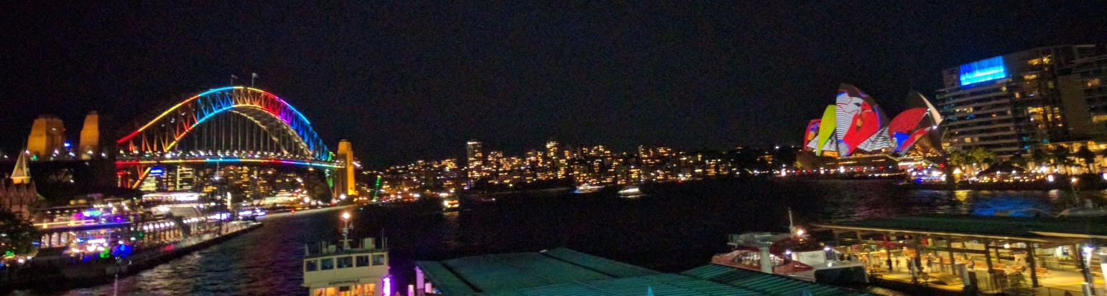
Examples of visual search problems
Is there a weapon here?
Where are my kids?
Which buildings are lit up for Vivid?

Slide 49
Let’s do some desk-slapping! Your task is to find this shape:

Slide 52
Serial search
That second one was more difficult than the first one.
The more distracting objects we have (set size), the harder it is to find the target….
1200
Search time “RT”
800
400
2
4
8
16
Set size

Slide 53
More desk-slapping! Your task is to find this shape:

Slide 56
Parallel search
That last one was still very easy.
It seems no more difficult than the first one.
So: more distractors ≠ harder search
1200
Search time “RT”
800
400
2
4
8
16
Set size

Slide 57
“Pop out” effects
(again!)
When the target is defined by a specific feature (e.g., colour) it seems to “pop-out”.
The “set-size” (number of distractors) makes no difference.
Doesn’t matter much what kind of feature it is (colour, shape, size, orientation, motion, depth)…

Slide 58
X
X
X
X
X
X
X
X
X
X
X
X
X
X
X
S
X
X

Slide 62
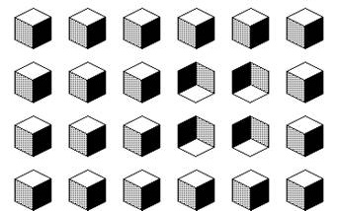

Slide 63
Detecting features occurs in parallel
“Feature maps” analyse the visual field and extract these primitive features in parallel.
Hits on a particular analyser map lead to fast detection of the target item.
All the distinctive items “pop out” suggesting that each feature is processed separately
(Triesman 1986: feature integration theory)

Slide 64
Binding features into objects is not
When the target is a combination of attributes (“conjunction”), a slow serial search process is needed.
We can extract the features (red and blue) in parallel
But we need attention “bind” them into objects.
This is hard to find, and does not pop out
(Triesman 1986: feature integration theory)

Slide 65
Theoretical implication
Early in processing the features aren’t bound together into objects
Binding happens late and requires attention

Slide 66
Report the two black numbers.
One will appear to the left, one to the right.
9 O T X 3
Hands up if you saw a purple T
Hands up if you saw a red R
Hands up if you saw a green X

Slide 67

Illusory conjunction
9 O T X 3
(Note: Branka Spehar talked about illusory conjunctions & the binding problem)

Slide 68
Illusory conjunctions support Triesman’s feature integration theory.
Feature extraction occurs automatically and in parallel; object recognition requires feature binding.
(Accurate) binding of features requires slow serial attentional processing of stimuli.
If this is not allowed, then errors in binding will occur and will be based on features extracted automatically during early perceptual processing

Slide 69

Key topics
Part 1 – Different kinds of attention
Part 2 –
Cocktail party problem
Early selection, late selection, etc
Semantic interference
Part 3 –
Visual analogs of shadowing tasks
Negative priming effects
Part 4 –
Serial vs parallel search
When do pop out effects occur?
Feature integration theory

Slide 70
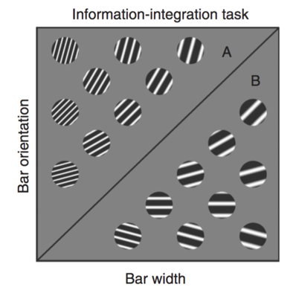
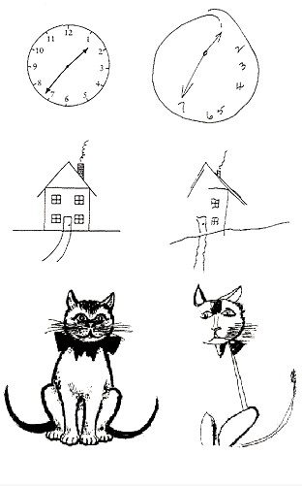
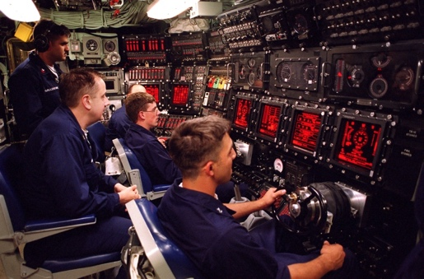
But there’s lots more to attention!
Attention & learning
Auditory attention
Divided attention
Disorders of attention
Visual attention

